Slide 1
Historical Perspectives and Organizational Soul
Understanding Unique Concepts

Slide 2
Getting Started
Welcome Back
Student Forms
Syllabus
Schedule
Books

Slide 3
Business is Changing
An intriguing development on the organizational horizon involves a developing relationship between two odd bedfellows, business and spirituality.
The interest has become pervasive.

Slide 4
Perspectives
Personal transformation approach
Group dynamics approach
Organizational development approach, or
Societal change approach.

Slide 5
Expression
“Faith at Work Movement”
“Spirituality in the Workplace Movement”
“Conscious Capitalism Movement.”
All are seen to be part of a much larger societal and global awakening that is taking place in these challenging times.
For the sake of simplicity, in this course, we are simply referring to the movement as Spirituality and Business.

Slide 6
Basic Cause
The natural desire of the human person to
Find meaning in their lives
To be connected

Slide 7
Last of the Conversations
Authority and Empowerment
Personal development
Gender
Mental Illness
Alcoholism and other addictions
Sexuality

Slide 8
Historical Analysis
Old Testament Teachings
New Testament writings
Monastic Orders
The decline of agrarian life
Rise of cities and urban communities
Industrial revolution
The Reformation
The enlightenment with its emphasis on humanism and evolution
The Marxist critique of religion and capitalism
Beginnings of Catholic Social Teaching
The Response of Weber

Slide 9
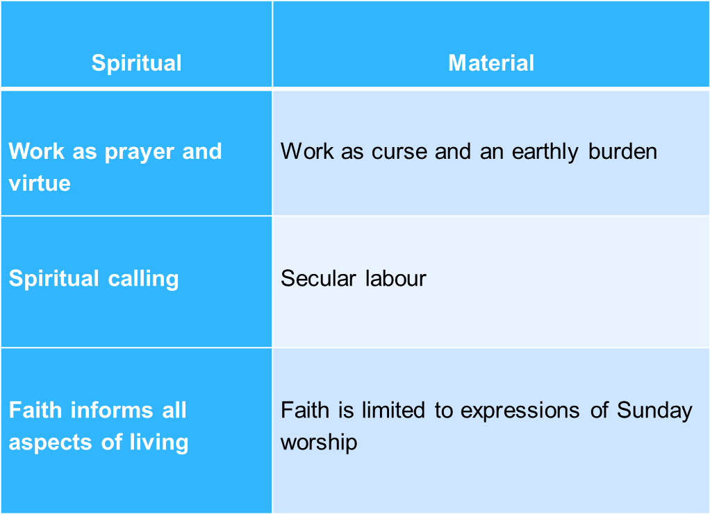
Revalations of Theological History

Slide 10
Conclusions At This Point
The notion of an interrelationship between spirituality (faith) and business (work) is not new
The discussion engages one in diversity that crosses religious boundaries

Slide 11
Sources of Fresh Interest
The natural desire to have an integrated life
The breakdown of the psychological contract.
An enhanced level of education that is more broadly distributed
A general sense of alienation that arises from the growing complexity of modern life.
Changing economic, societal and ecclesiastical environments
A rediscovery of the need for the experience of connection

Slide 12
The Forces at Work
A New Sensitivity to Workforce Issues
Advances in Science and Health Care
Rapid rise in social interest
Social Gospel
Ministry of the Laity

Slide 13
Social Gospel
Conservative Social Christianity
Radical Social Christianity
Progressive Social Christianity

Slide 14
Ministry of the Laity
Ecumenism
Special Purpose Groups
The Popularization of Lay Ministry

Slide 15
Other Predominant Factors
The emergence of strong leadership figures
The development of a theology of the laity
The rise and decline of a focus on lay ministry at the World Council of Churches
A dialogue between Protestantism and Roman Catholicism.

Slide 16
The 2nd Vatican Council
Gaudiem et Spes – a new framework for understanding self in the modern world including life in the economic sphere
The Dogmatic Constitution on the Church which included a chapter on the laity offering a nascent theology of the laity
The Decree on the Apostolate of the Laypeople which continued the new emphasis on lay responsibility within and outside the church walls.

Slide 17
Dr. Judy Neal
Business is beginning to investigate new inner frontiers. While spirituality may enhance results when integrated into the workplace, its presence is still fragile. The challenge is to accept that certain domains of reality may exist beyond the scope of modern measures that are both healthy for individuals and productive for corporate activities.

Slide 18
The Concept of Organizational Soul
Dictionary
Immaterial Essence or Essential Nature
Bolman & Deal
Soul is a bedrock sense of who we are, what we
care about and what we believe in.

Slide 19
More Definitions
Religious Definition:
The vital essence of a person that cannot be reduced to the matter from which the body is constructed.
Csikszentmihalyi:
The energy a person, an organization, or a corporation devotes to objects beyond itself.

Slide 20
Concepts to Build On
It is spiritual work in the same way that there is a spiritual dimension to everything that we do.
To live spiritually is to take responsibility for both our gifts and our actions.
To live spiritually is to be in a relationship characterized by honesty and integrity.
To live spiritually is to live in accord with our purpose in life as we constantly strive to know it more deeply.

Slide 21
Thought Provoker

